Slide 1

HOTEL AGGREGATOR ANALYSIS
HOTEL
USING POWERBI
BY: MIRACLE OGUNNUSI

Slide 2
CONTENTS
01
02
Problem Statement
Data Cleaning and Preparation
The aim of the project and what we are looking to achieve.
Modifying data that is incorrect, incomplete, irrelevant, duplicated or improperly represented.
03
04
Data Analysis & Reports
Recommendations
Analyzing data using PowerBi and explaining our findings.
Making suggestions of what can be done to improve performances based on our analysis.

Slide 3

PROBLEM STATEMENT
This project is aimed to analyze a dataset of hotel aggregator listings using Power BI. The dataset comprises various attributes related to listings, hosts, reviews, and availability.
The objective is to create comprehensive visualizations and insights that shed light on trends, patterns, and factors influencing the performance of listings. Through Power BI, we will explore key metrics such as pricing, availability, host characteristics, and review scores to derive actionable insights for improving the overall quality and competitiveness of the listings.

Slide 4
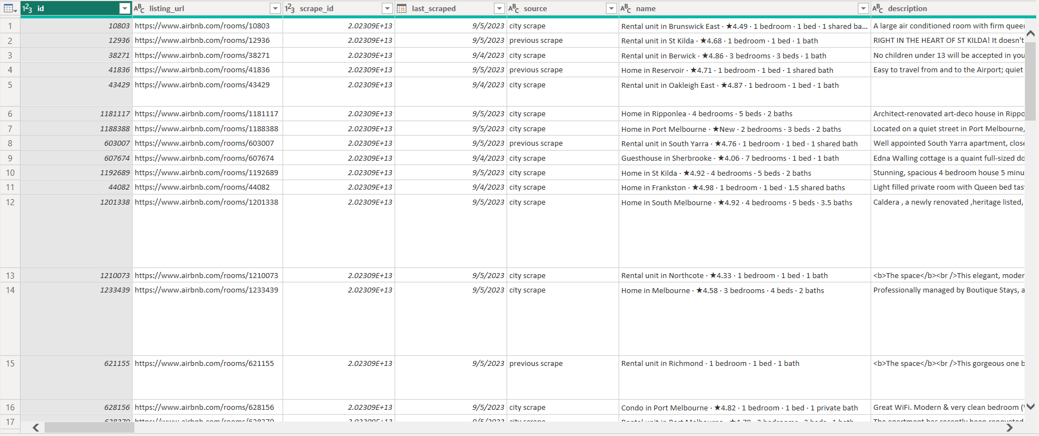
Data Cleaning and Preparation
Loaded our dataset into PowerBi.
Checked for and removed duplicates, blank rows, and errors.
Replaced values on some columns
,

Slide 5
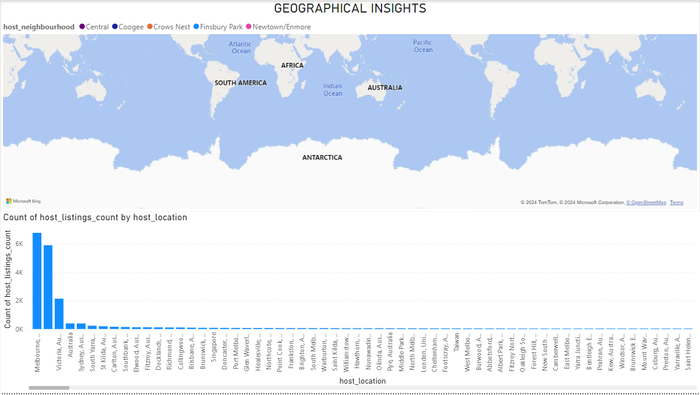
Data Analysis And Reports
Geographical Insights
Visualize the distribution of listings on a map to identify popular neighborhoods
Explore the geographical concentration of listings and host locations
Popular neighborhoods (limited to 5)
Central Business District
Coogee
Crows Nest
Finsbury Park
Newtown/Enmore
Melbourne, Australia has the highest count of host listing count.

Slide 6
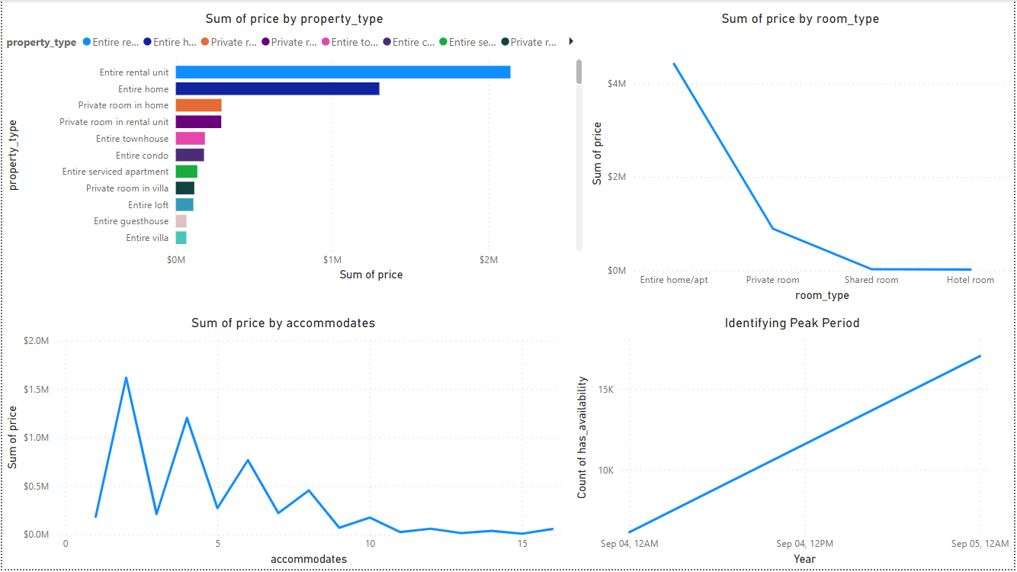
Pricing and Availability Analysis
Analyze pricing trends based on property types, room types, and accommodation capacity.
Investigate the availability of listings over time and identify peak periods.
Entire Rental Unit had the highest price.
Entire home/apt had the highest price.
Price varies as the capacity of accommodates increases.
Peak period was September, 2023.

Slide 7
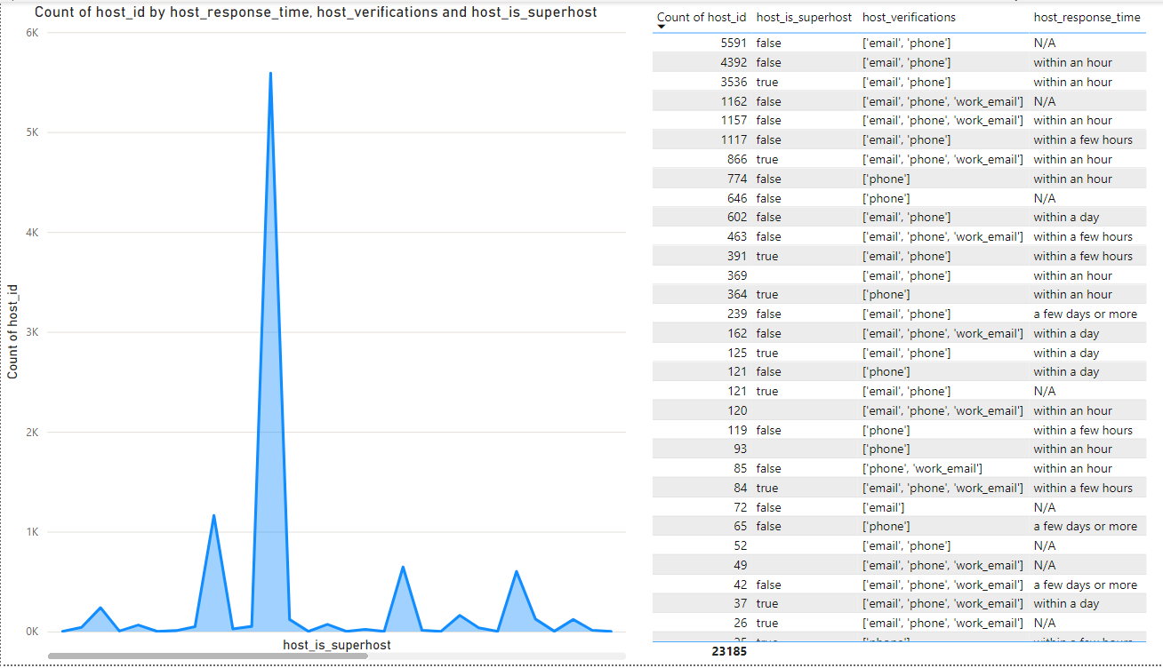
Host Performance
Evaluate host characteristics, including super host status, response times, and verification methods.
Explore correlations between host attributes and listing performance.
Most Common Superhost Status
False had the highest total number of hosts (74.28%).
Most Common Verification Combination: Combination of email and phone verification has the highest total number of hosts (69.99%).
Fastest Response Time
Listings with response time within an hour have the highest total number of hosts (58.27%).

Slide 8
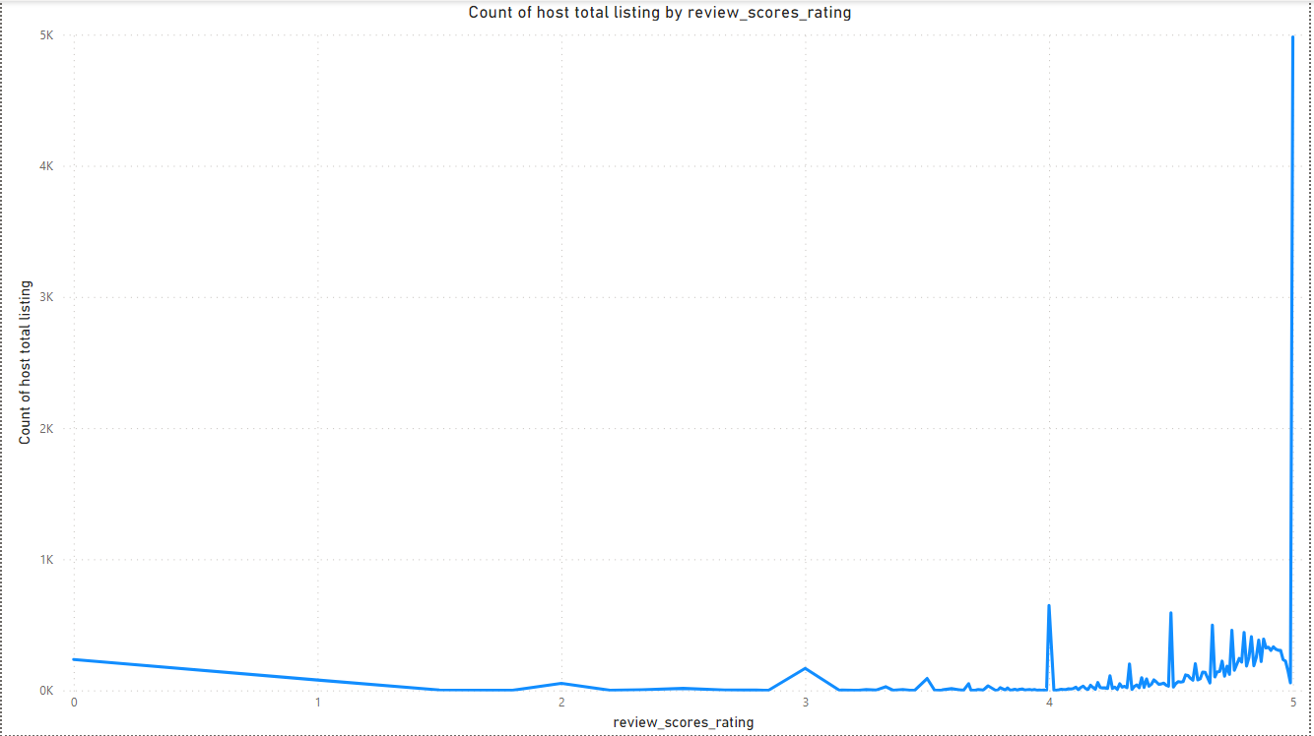
Review Scores and Guest Satisfaction
Examine review scores and their impact on overall listing performance.
Identify areas for improvement based on specific review categories.
﻿﻿Count of host total listing was highest for 5 at 4,983, followed by 4 and 3.﻿﻿
﻿﻿5 accounted for 21.49% of count of host total listing .﻿﻿
﻿﻿Across all 164 review scores rating, count of host total listing ranged from 1 to 4,983.﻿﻿

Slide 9
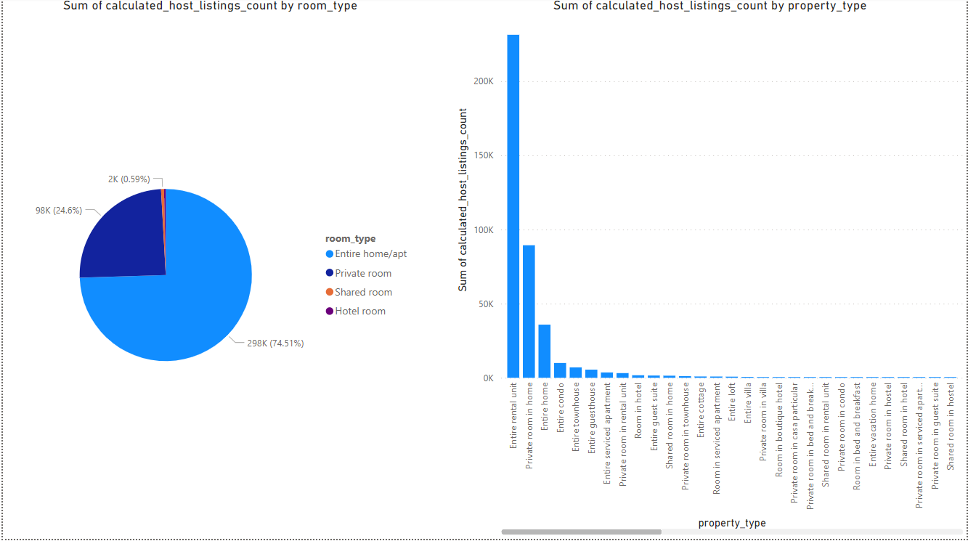
Property Type and Room Analysis
Analyze the distribution of property types and room types.
Explore trends in the popularity of specific accommodation setups.
Entire home/apt accounted for 74.51% of the sum of calculated host listings count, followed by Private room, Shared room, and Hotel room.
﻿Entire rental unit has the highest sum of calculated host listings count at 231346, followed by Private room in home and Entire home.

Slide 10

RECOMMENDATIONS
Geographical Insights
For hosts: More focus should be on listings in popular neighborhoods such as Melbourne, Australia, which has the highest count of host listings, and listings should be optimized in these areas to attract more guests.
For the aggregator platform: Targeted marketing and promotional support should be provided for listings in popular neighborhoods to increase visibility and booking opportunities.
Pricing and Availability Analysis
For hosts: Analysis of pricing trends based on property types, room types, and accommodation capacity should be done often to ensure competitive pricing. Pricing strategies should be optimized during peak periods to maximize revenue.
For the aggregator platform: Data-driven pricing recommendations should be offered to hosts to optimize pricing strategies and improve listing performance.
Host Performance
For Hosts: Hosts should aim for superhost status by providing exceptional hospitality, maintaining cleanliness, and garnering positive reviews.
Hosts should ensure email and phone verification for all listings to build trust and credibility.
Hosts should maintain a fast response time, ideally within an hour, to increase booking opportunities and
guest satisfaction.
For the Aggregator Platform: Training and support should be given to hosts to encourage them to aim for superhost status.
.
The importance of verification for hosts should be provided to enhance trust among guests.
Tools should be provided to hosts to streamline communication and response management to ensure timely
responses.

Slide 11
RECOMMENDATIONS
Review Scores and Guest Satisfaction
For hosts: Attention should be given to specific review categories such as accuracy, cleanliness, communication, and location to identify areas for improvement. Measures should be implemented to address guests’ issues and enhance overall guest satisfaction.
For the aggregator platform: Hosts should be provided with resources and support to improve review scores and enhance guest satisfaction, ultimately improving the platform's reputation and attracting more guests.
Property Type and Room Analysis
For hosts: The distribution of property types and room types should be analyzed to understand trends in guest preferences. Accommodation setups should be considered diversified to cater to different guest needs and preferences.
For the aggregator platform: Insights and recommendations should be offered to hosts on popular property types and room setups to optimize listing configurations and improve booking rates.
By implementing these recommendations, hosts can enhance their listing performance, improve guest satisfaction, and maximize revenue potential. Similarly, the aggregator platform can strengthen its offering, attract more guests, and maintain a competitive edge in the market.

Slide 12
Thank you
HOTEL
ANALYZED BY: MIRACLE OGUNNUSI

